Slide 1
Lecture 1 (06/26)
Signal Modulation
Introduction (Signals)
Signal Analysis
Advantages of Signal Modulation
Amplitude Modulation
Amplitude Modulation of Digital Signals
Reducing Power and Bandwidth of AM Signals
Frequency Modulation
Power and Bandwidth of FM Signals
Conclusion

Slide 2
Introduction
(Signals)
The tasks of communication is to encode information as a signal level, transmit this signal, then decode the signal at the receiver.
An analog signal varies continuously with time, and has an infinite number of possible signal levels.
A discrete signal changes only once during a certain time interval. The signal value during this time interval (sampling period) is one sample. Each sample can occupy a infinite number of possible levels.
A digital signal is discrete, but each sample has a finite number of possible signal levels. The limited number of levels means that each sample transmits a single information. It also means that each sample can be represented as digital data, a string of ones and zeroes.
A digital signal is preferred in computer communications because computers already store and process information digitally.

Slide 3
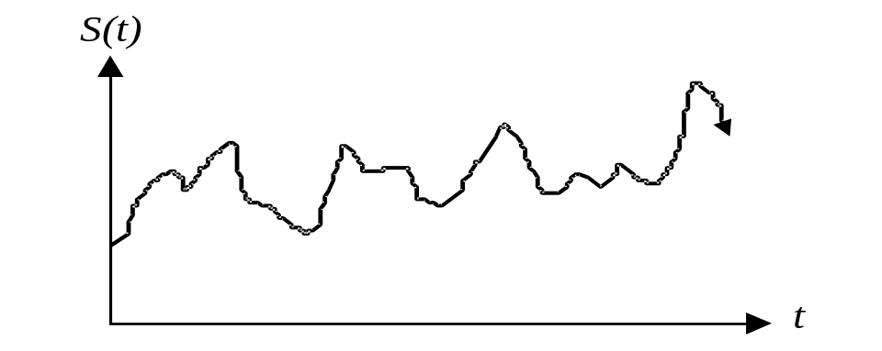
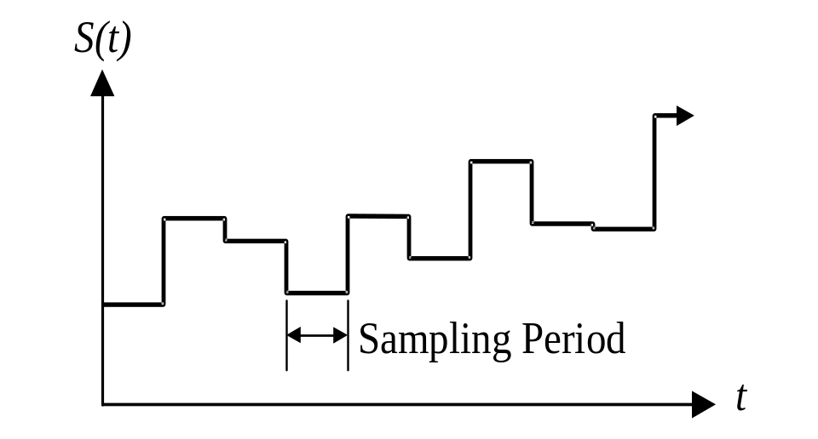
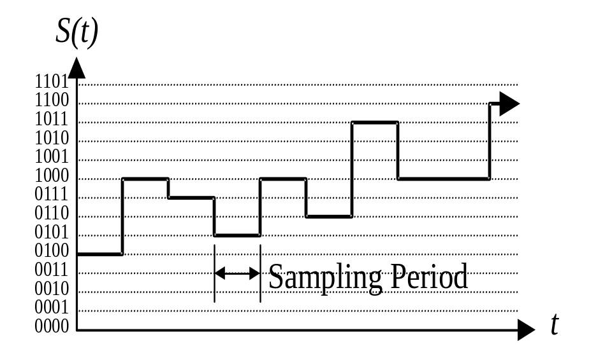
In an analog signal noise are added to the signal during transmission, and signal processing. The received signal will never be identical to the original signal.
A discrete signal changes only once during some time interval. The signal value during this time interval (sampling period) is one sample. Each sample can occupy a infinite number of possible levels.
A digital signal will still be subject to noise, but the difference between signal levels (an “0101” and an “0110”) will be sufficiently small, so that the receiver can always determine the original signal level. The regenerated, received digital data is an exact replica of the original digital data.
Analog to digital conversion reduces the amount of information of the signal by approximating the analog signal with a digital signal. (Reading 1).

Slide 4
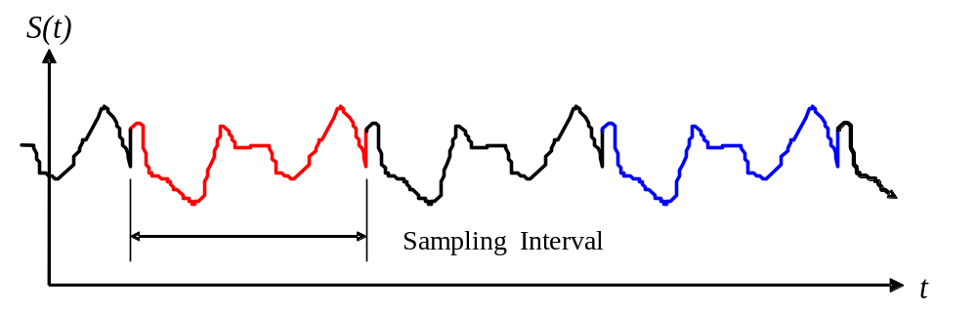
Signal Properties
A periodic signal satisfies the condition:
“Period” of the signal.
“Aperiodic.” signals
An even function S (t) = S (-t)
“Symmetric”.
The phase of the signal.

Slide 5
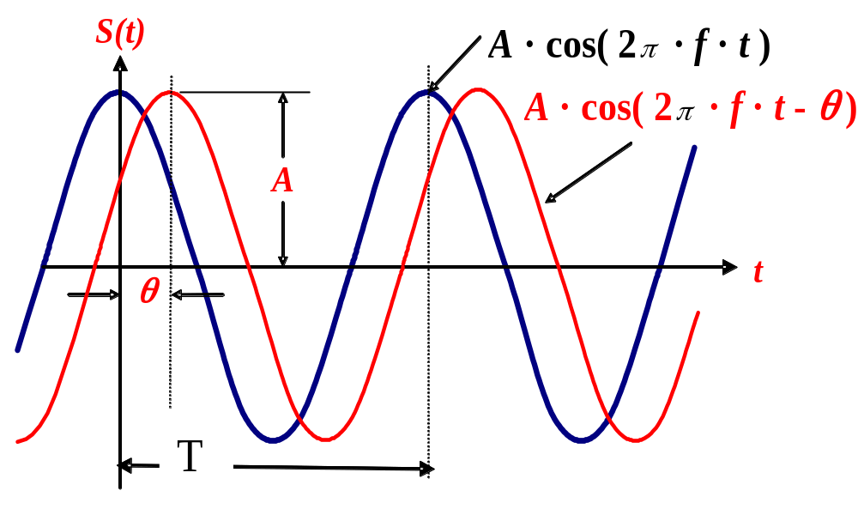
A
A
f
1/T
A
θ=0
A
1/T
f
θ=π/4
1/T
f

Slide 6
Digital signals in the time and the frequency domain.
The time domain is the signal level expressed as a function of time.
The frequency domain is comprised of amplitude and a phase for an infinite number of sinusoidal functions. Signals in the time domain correspond to the superposition of an infinite number of sinusoidal waveforms in the time domain.
To convert signal from the time domain to the frequency domain, we take the Fourier transform of the time domain representation.
The frequency domain representation of a signal does not change with time, but the Fourier transform for the signal over an infinitely long time period would be impossible. Instead, we assume that the signal has some finite duration, over a sampling interval:
1. We assume that outside of the sampling interval, the signal repeats itself, so that the signal is periodic.
2. An alternative assumption is that the time-domain signal has a zero value outside of the sampling interval, so that the signal is aperiodic.

Slide 7
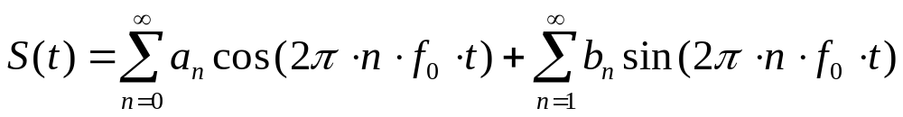
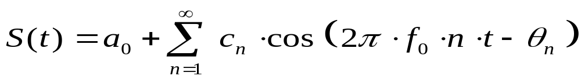
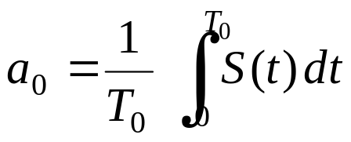
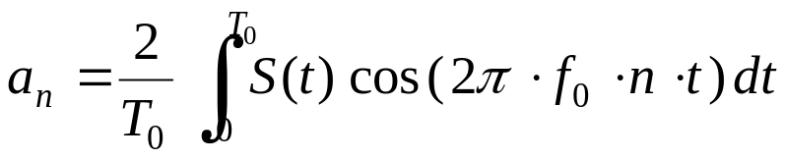
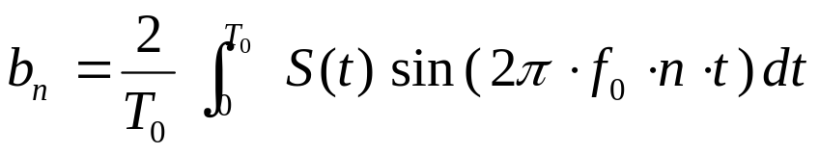
Fourier Series Expansion of Periodic Signals
a. There are a finite number of discontinuities in the period T.
b. It has a finite average value for the period T.
c. It has a finite number of posit. and negat. Max. in the period T.
f0 -Fundamental Frequency
n · f0 -Frequency of each term
an, bn- Fourier series coefficients:

Slide 8
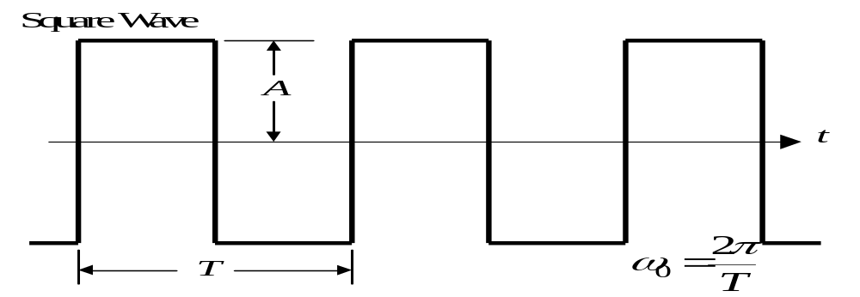
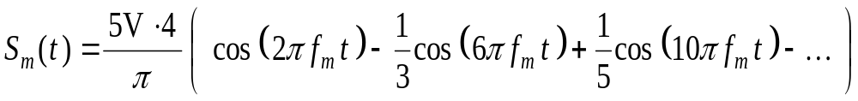
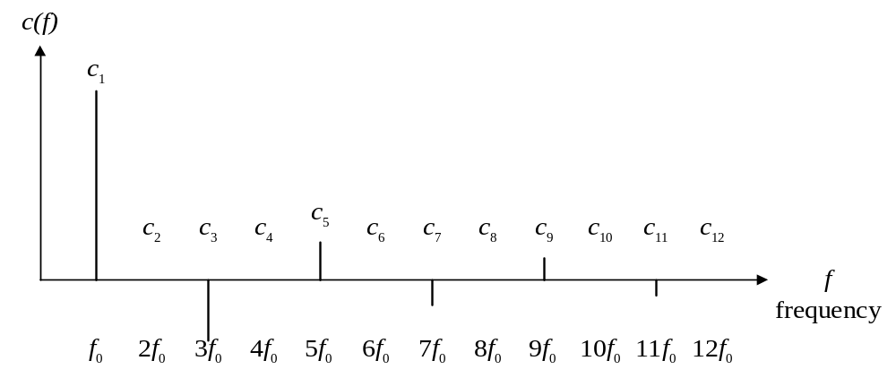
Amplitude Spectrum

Slide 9
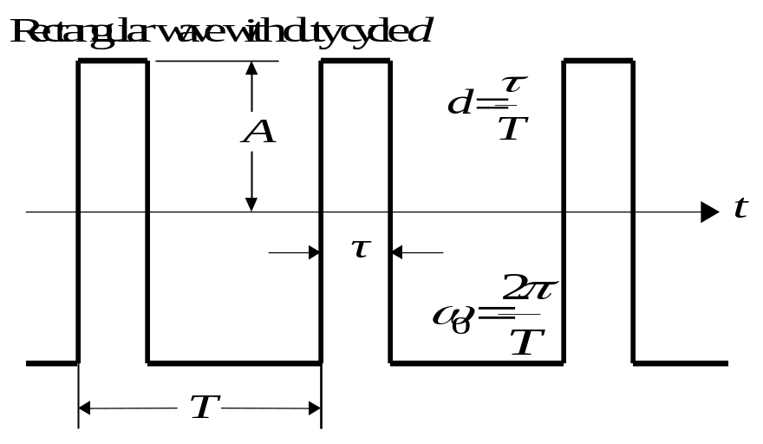
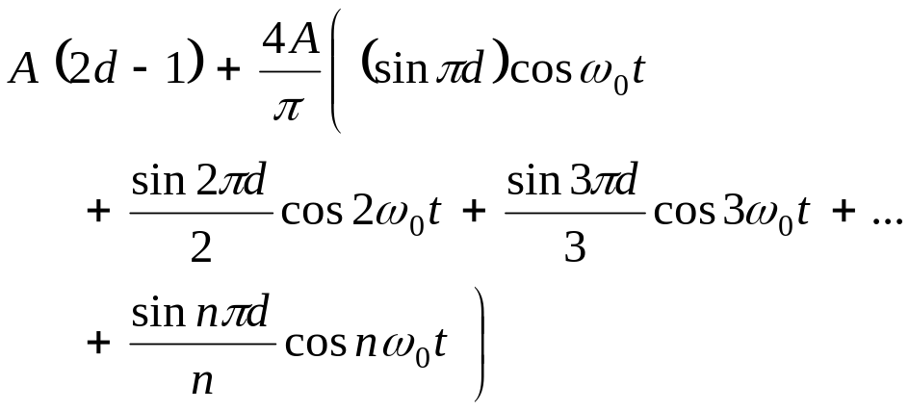
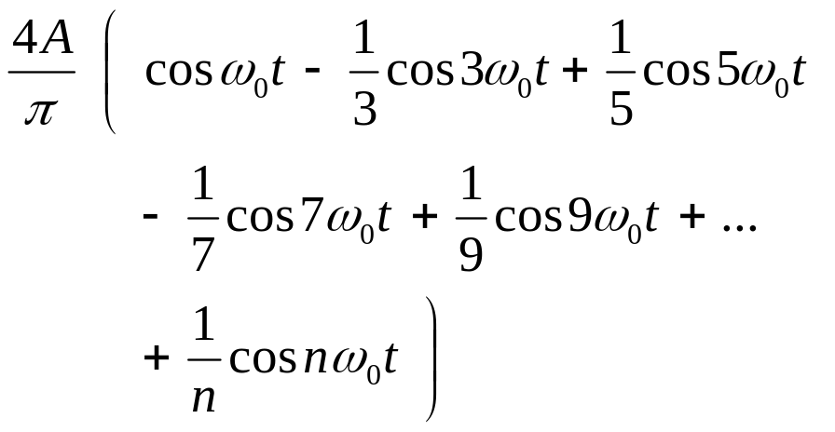

Slide 10
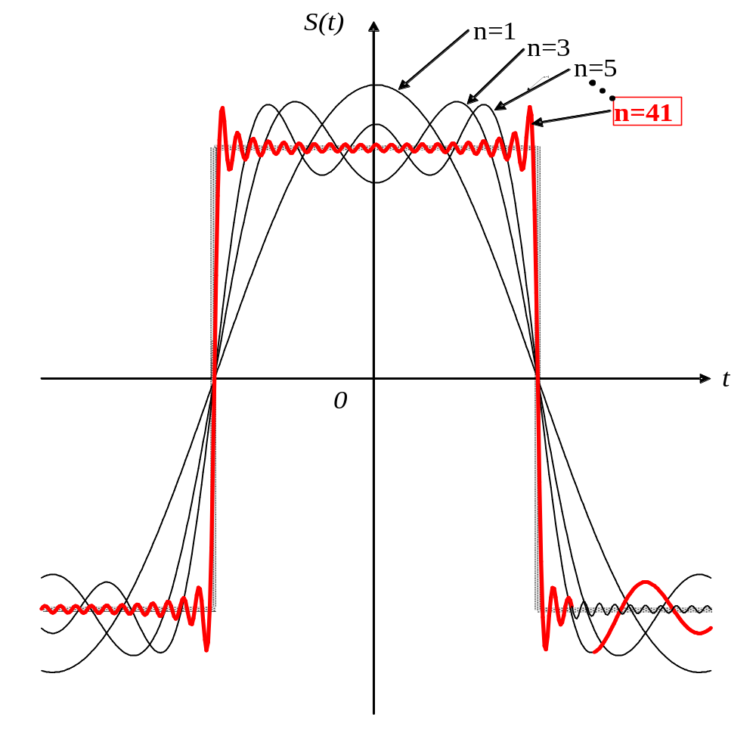

Slide 11
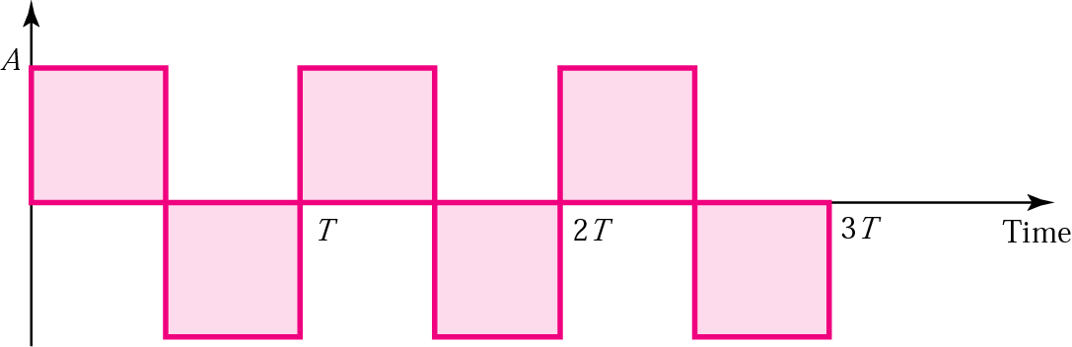
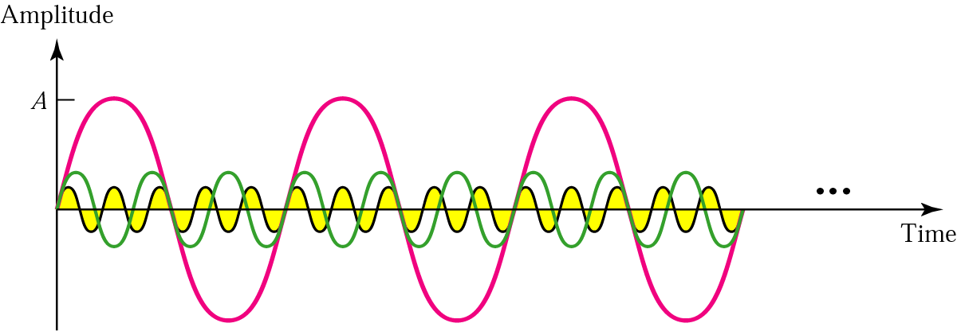
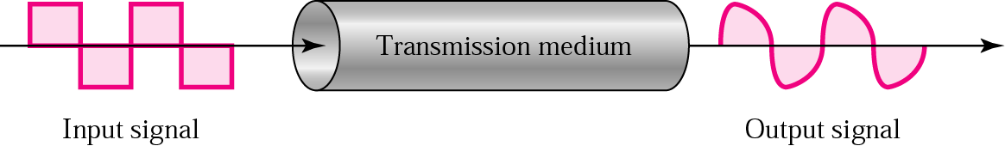
Square wave
Three harmonics
Signal corruption

Slide 12
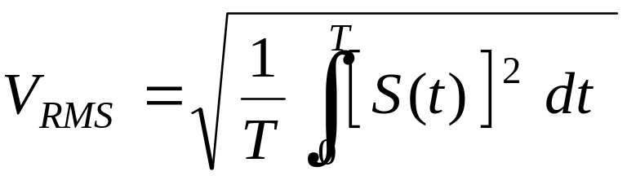
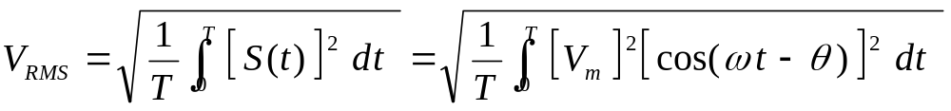
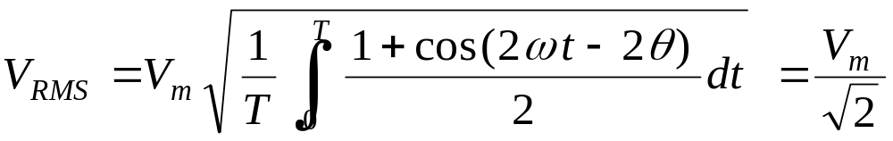
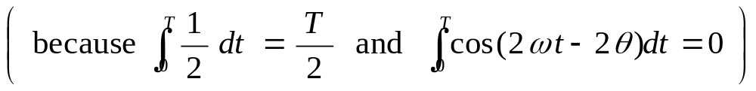
RMS Voltage Values and Power Spectrum
By the definition RMS voltage is the square root of the average value of the voltage squared, taken over one period of the signal:
For a sinusoidal signal:

Slide 13
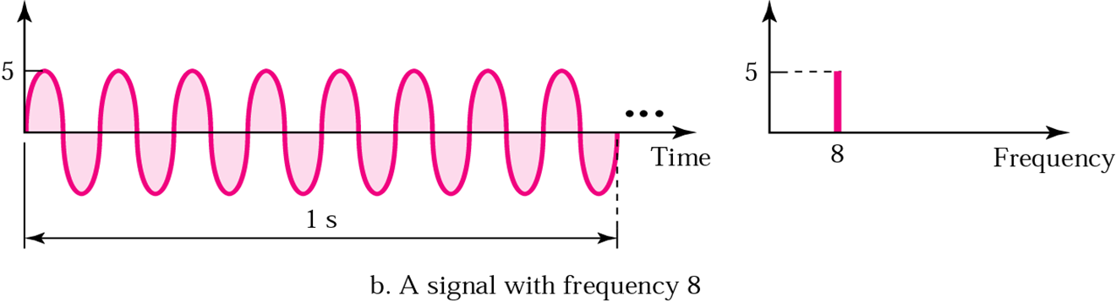
Time and frequency domains
Volt
Amplitude Spectrum
rms
3.55
8
Frequency
Power Spectrum

Slide 14
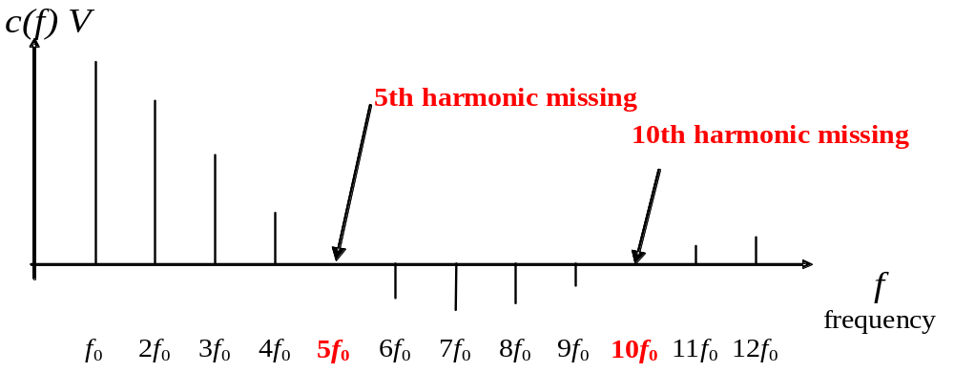
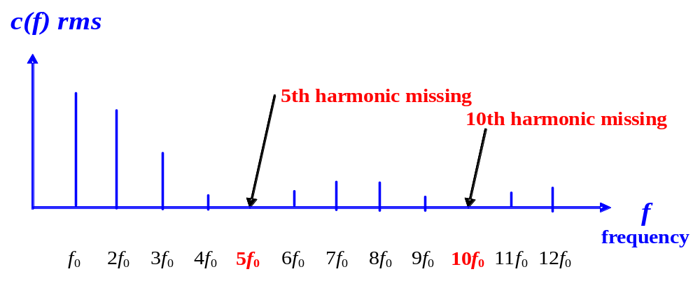
Fourier spectrum for rectangular signal is:
Ak
Amplitude Spectrum
By the definition RMS
Ak / 1.41
Power Spectrum

Slide 15
According to Fourier analysis, any composite signal can be represented as a combination of simple sine waves with different frequencies, phases, and amplitudes.

Slide 16
Introduction
A network and transport layers basic services comprise the end-to-end transport of the bit streams over a set of interconnected routers (switches).
They are produced using six basic mechanisms:
a. Multiplexing
b. Switching
c. Error control
d. flow control
e. congestion control
f. and resource allocation.

Slide 17
Multiplexing Combines data streams of many users into one large bandwidth stream. Users can share communication medium. (Bandwidth is a frequency band that contains more than 50% power of the signal full power)
a. Switch b. Multiplexer/Demultiplexer
a. Fully connected network
b. network with shared links.

Slide 18
Signal Modulation is:
The process of encoding a baseband (data), source signal S_{m} (t) onto a carrier signal.
The carrier waveform is varied in a manner related to the baseband (Data) signal.
The carrier can be a sinusoidal signal (or a pulse signal). The result of modulating the carrier signal is called the modulated signal.

Slide 19
Signal Modulation
S_{c} ( t ) = A · cos ( 2π f t+ φ )
A. Amplitude Modulation (AM), or Amplitude Shift Keying (ASK): The amplitude A of the carrier signal changes in proportion to the baseband signal.
B. Frequency Modulation (FM), or Frequency Shift Keying (FSK): The frequency f of the carrier changes in proportion to the baseband signal.
C. Phase Modulation (PM), or Phase Shift Keying (PSK): The phase φ of the carrier signal changes in proportion to the baseband signal.

Slide 20
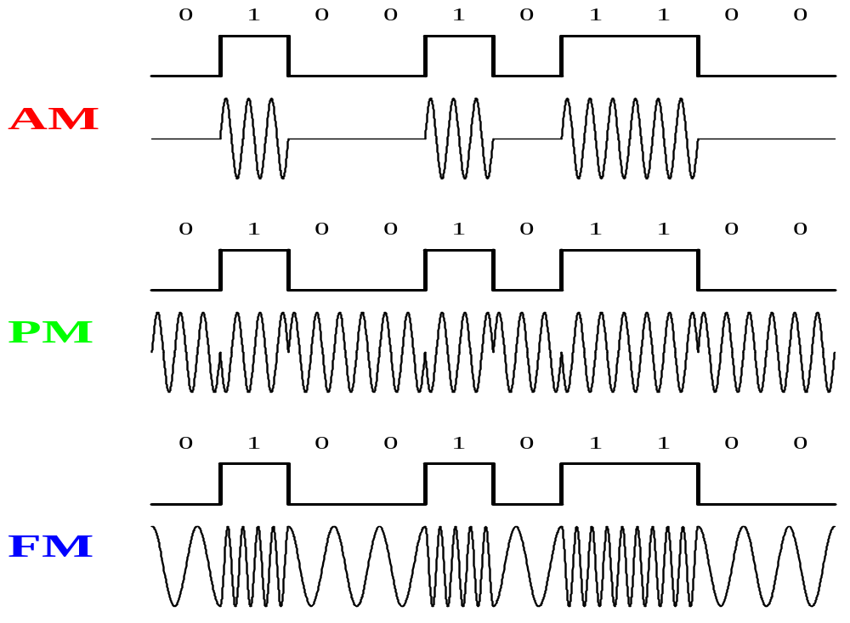
Amplitude, Phase, and Frequency Modulation by digital baseband signal

Slide 21
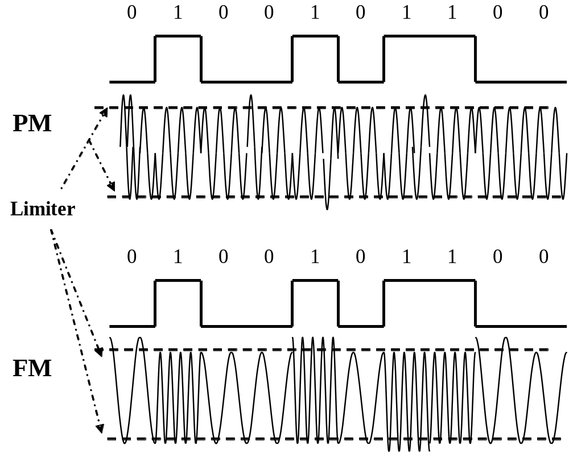
PM and FM with additive noise

Slide 22
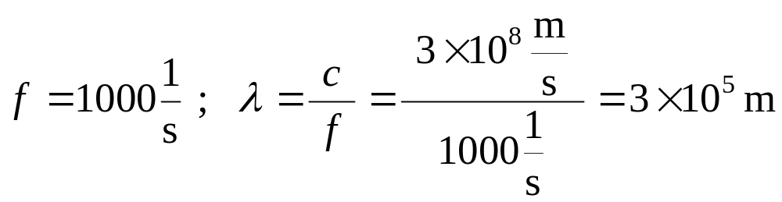
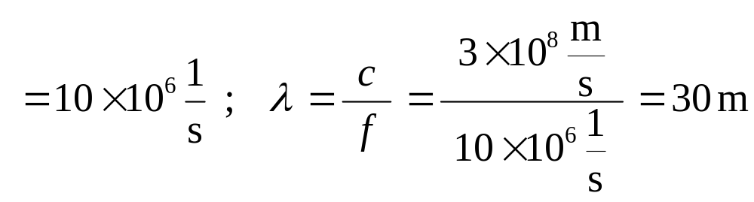
Advantages of Signal Modulation
Radio transmission of the signal.
Sc ( t ) = A · cos ( 2π fc )
Frequency range of modulated is (fc + f) and (fc - f) .
fc
For 5GHz frequency Wavelength =6 cm
FDM WDM

Slide 23
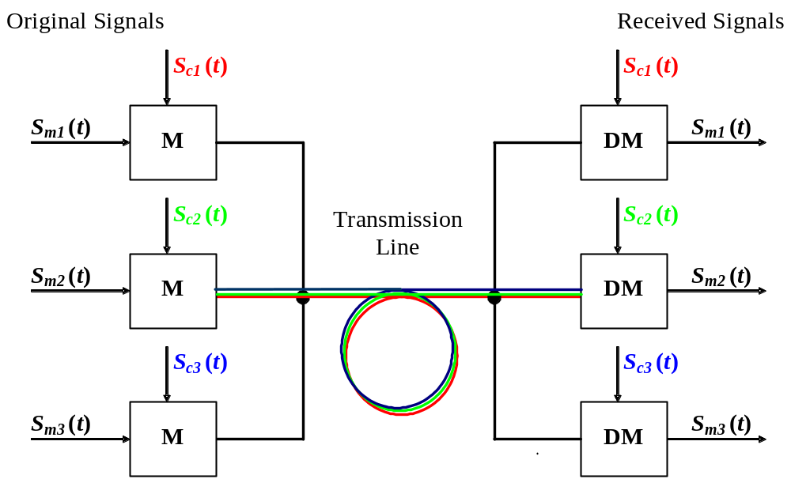
FDM
Guard band
f
fc1-fm1 fc1 fc1+fm1 fc2-fm2 fc2 fc2+fm2 .......................

Slide 24
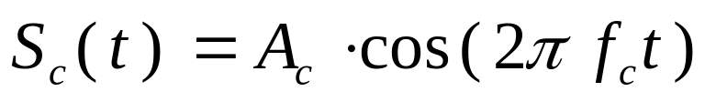

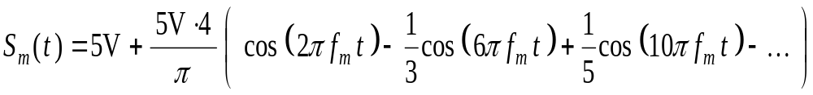
Amplitude Modulation by Digital Signals
AM is multiplication of the baseband signal with the carrier signal.
X
Sm ( t )
Baseband Digital Signal
Sinusoidal Carrier Signal
Baseband Digital Signal with DC shift

Slide 25
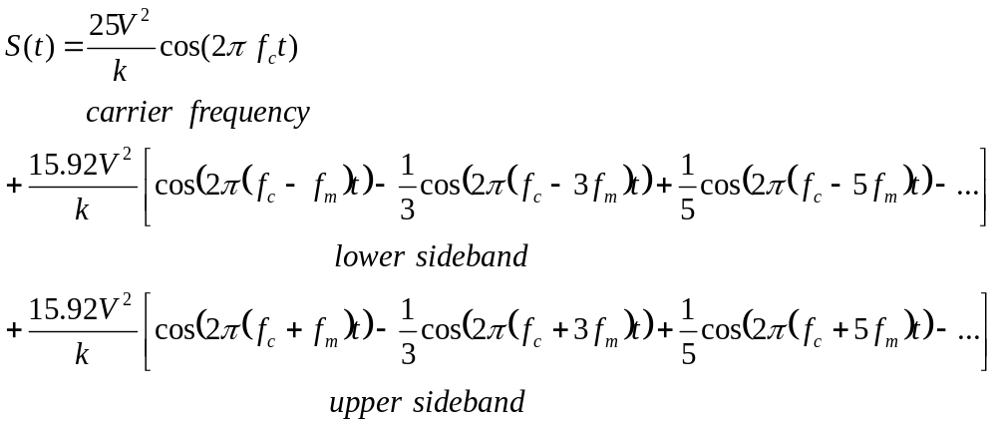
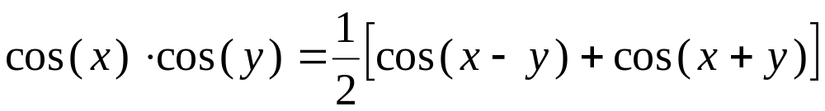
Transmitted Signal
In the above formula is used the trigonometrical identity:

Slide 26
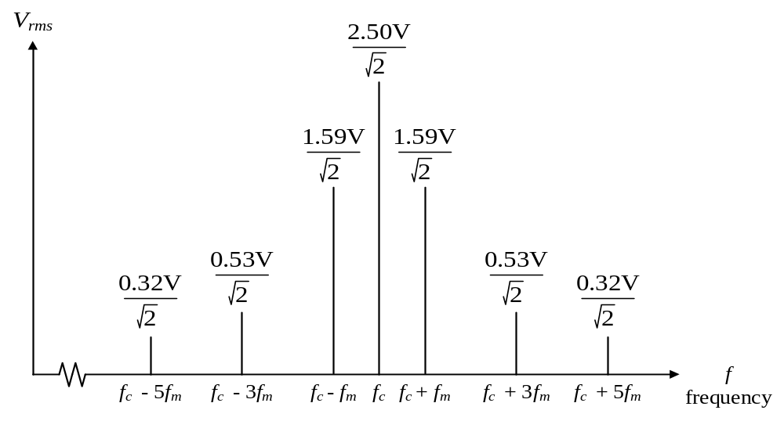
DSBTC AM signal with square wave baseband signal, i = 100%, k = 10.
Power Spectrum
Bandwidth

Slide 27
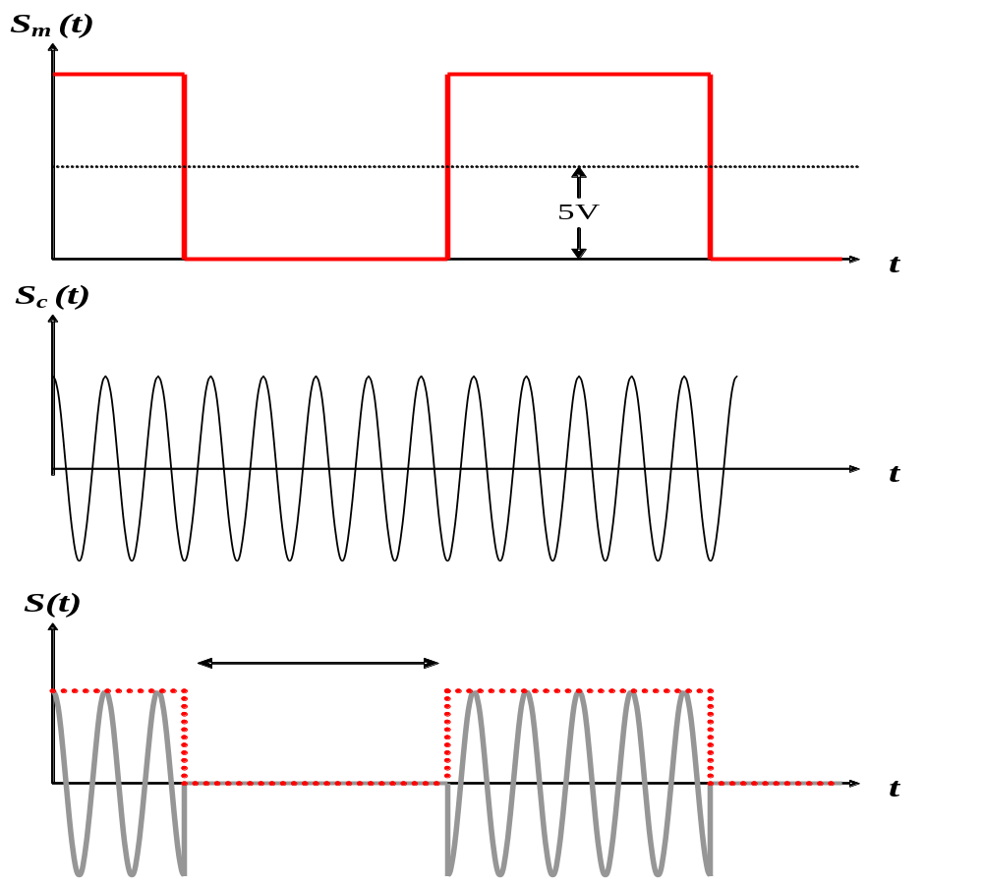
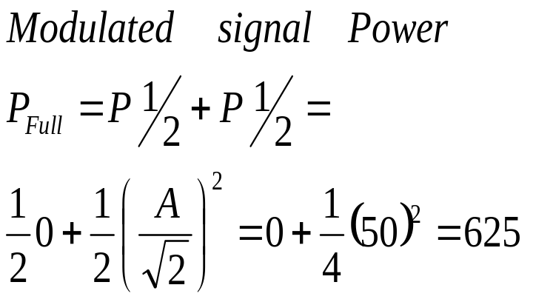
10V
5V
1/2
50V
1/2

Slide 28
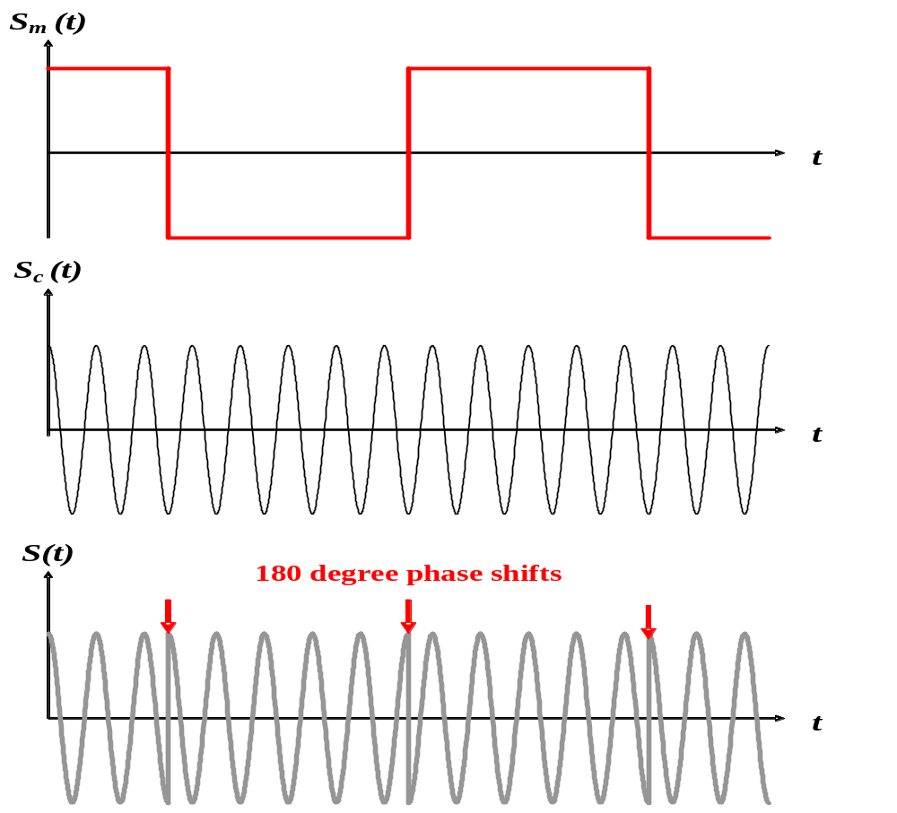
If DC offset of the data signal =0
X
=

Slide 29
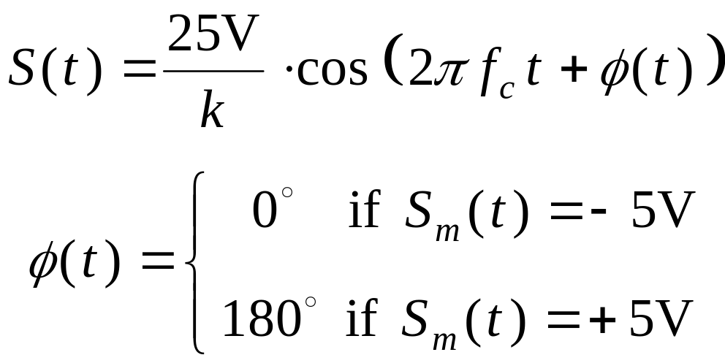
Binary Phase Shift Keying and Quadrature Phase Shift Keying
Since the phase of the transmitted signal can take one of two values (phase jumping), this type of modulation is called binary phase-shift keying (BPSK). It is a constant-amplitude method of modulation.

Slide 30
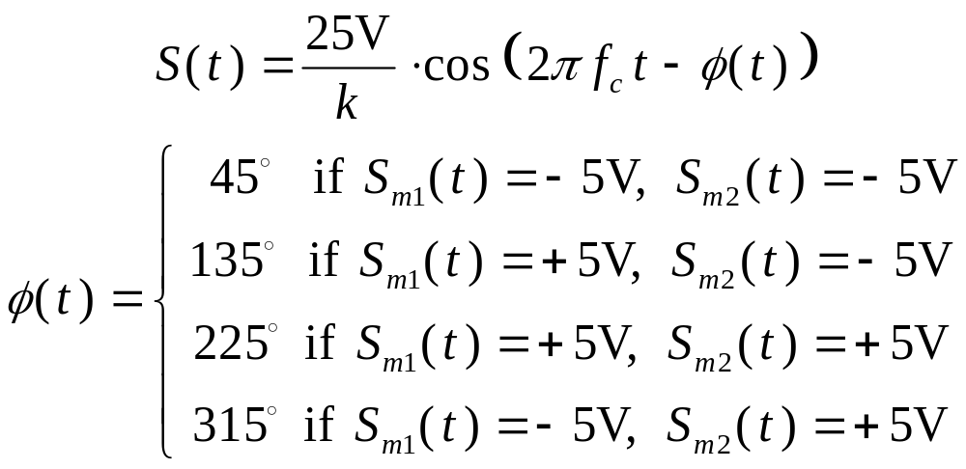
If we add together two BPSK signals that are offset by a 90 degree phase shift, there are four possible phase jumping during every sampling period. Instead of one possible shift of 180º, there are three possible transitions: +90º, 180º, and ‑90º (+270º). The signal can be represented by the following formula:

Slide 31
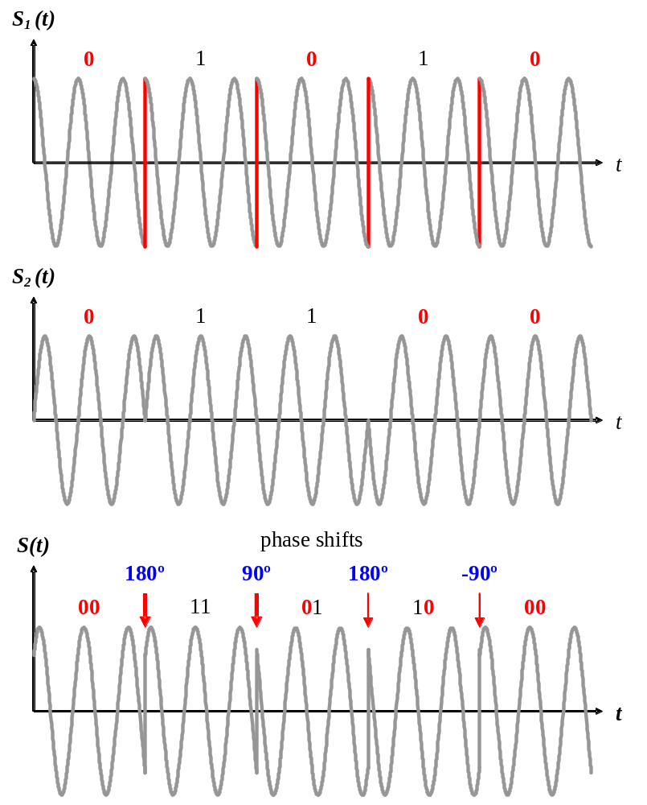
Time domain representation of QPSK signal, created: by combining BPSK signals S1 and S2 .

Slide 32
Concept 1:
The total bandwidth required for AM can be determined from the bandwidth of the audio signal:
BWt = 2 x BWm.
Example
We have an audio signal with a bandwidth of 4 KHz. What is the bandwidth needed if we modulate the signal using AM? Ignore FCC regulations.
Solution
An AM signal requires twice the bandwidth of the original signal:
BW = 2 x 4 KHz = 8 KHz

Slide 33
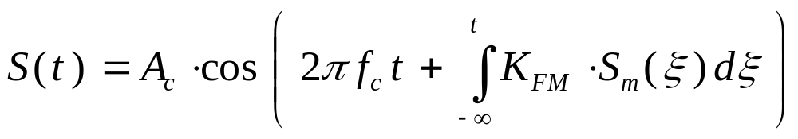
Frequency Modulation
Frequency modulation is a special case of phase modulation, where the transmitted signal phase accumulation changes frequency in accordance with the amplitude of the baseband signal:
Additive noise
KFM: Constructional coefficient of the modulator

Slide 34
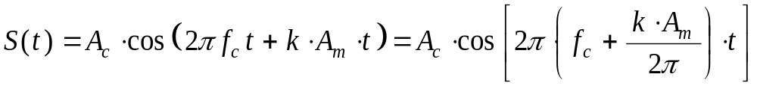
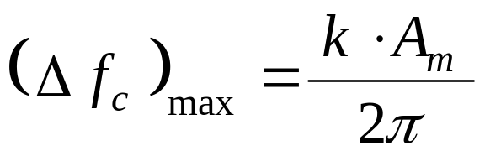
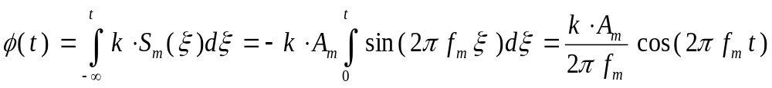
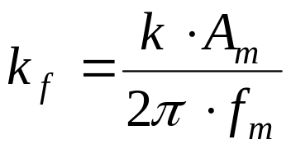
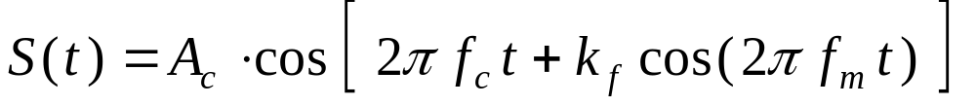
To find the maximum possible frequency deviation of an FM signal, we can assume the baseband signal is a constant voltage of +Am , then the integral will reduced to a linear function of t :
Sm ( t ) = Am · sin (2π fm t )

Slide 35
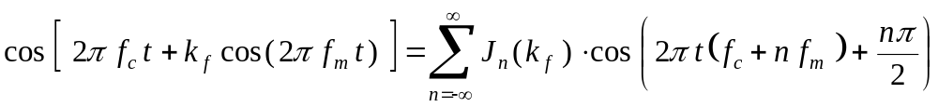



Equation can be expanded using Bessel's trigonometric identities into a series of phase-shifted sinusoidal terms.
The amplitude of each term is determined by the Bessel function of the first kind J_{n} ( k_{f} ), where k_{f} is the modulation index.

Slide 36

First five Bessel coefficients for varying values of kf .

Slide 37


Power and Bandwidth of FM Signals
Calculating the power of an FM signal is much simpler in the time domain.
In this equation B is effective bandwidth of baseband signal,
but BT is absolute bandwidth of FM signal

Slide 38

Ac · cos ( 2π fc + k_{f} cos ( 2π fm ) ) at various values of k_{f} .

Slide 39
Concept 2:
The total bandwidth required for FM can be determined from the bandwidth of the audio signal:
BWt = 10 x BWm.
We have an audio signal with a bandwidth of 4 MHz. What is the bandwidth needed if we modulate the signal using FM? Ignore FCC regulations.
Example 1
Solution
An FM signal requires 10 times the bandwidth of the original signal:
BW = 10 x 4 MHz = 40 MHz

Slide 40
THANK YOU!

